Slide 1
Information Literacy
How to navigate Magale Library’s website to find research information.

Slide 2
How to get to Magale Library’s website
Click on the “Library” tab on the Centenary home page
Notes:
www.centenary.edu/library

Slide 3
Magale Library’s home page
Bring your Centenary ID to the Circulation Desk and have a library account set up so you can check out materials.
List of all the databases that the library subscribes to
Library hours:
Mon-Thurs:
7:30am-11pm
Fridays:
7:30am-4:30pm
Saturdays: 1pm-5pm
Sundays: 3pm-11pm
Special hours will be posted on the website.
Additional resources available for research
Search for
library
materials
Notes:
If you need any help with research and finding materials, call, email or come by to speak with Ms. Jeannette at the reference desk (Sunday-Thursday, 3:00pm-11:00pm). Phone: 318-869-5047 Email: jcurtis@centenary.edu
Mention free black-and-white printing (no color), scanners, copier ($.10/page), class reserve materials, DVDs, Archives, and the music library (Hurley).
Click on the yellow “Electronic Card Catalog” button to search for library holdings. (Continued on the next slide.)

Slide 4
Looking for library materials
Search for books, eBooks, journals, or DVDs by typing in the title, author, keywords, etc. in the search box. Use the drop down menu to specify your search option. You can also do an Advanced Search.
If asked for a username and password (usually from off campus),
the username is: Centenary The password is: Mag318
Notes:
Access by clicking on “Electronic Card Catalog” in the yellow box on the previous slide.

Slide 5
Databases
Most popular databases for research:
Academic Search Complete
CQ Researcher
Gale Virtual Reference Library
JSTOR
LexisNexis
Also check out:
American Chemical Society
Annual Reviews
GeoScience World
Literati
Literature Resource Center
Oxford English Dictionary
Notes:
Access these databases from the Magale Library website to take advantage of these paid subscriptions.

Slide 6
Academic Search Complete
Notes:
Check the box to select only “Scholarly (Peer Reviewed) Journals” if required.
If you select the “Full Text” option, you will limit your search to those articles that we have access to. There may be many more articles on your topic that won’t show up in your search results. By leaving the “Full Text” option unchecked, you will see ALL articles on that subject. You can request an article through Interlibrary Loan (ILL) and we will request it to be sent from other libraries that have it.
Click on “Choose Databases” for the next slide.

Slide 7
“Choose Databases” options
Notes:
Academic Search Complete is a good, general database to use. You can also choose specific EBSCO subject databases along with Academic Search Complete to include more specialized results.

Slide 8
Searching for articles about “student athletes”
Notes:
Finding the right keywords makes all the difference in your search. Try different terms until you get the results you need.
Try using different Boolean search techniques between keywords: AND, OR, NOT.
Using parentheses (groups terms together with Boolean operators) or quotes (for exact phrases) in searches.
Make sure to check the box for “Scholarly (Peer Reviewed) Journals” if required for your research.
You can add articles to a folder to be viewed later.

Slide 9
Viewing a specific article
Citations can
be done in
MLA, APA, Chicago/ Turabian and other styles.
Notes:
Articles in HTML format have the option to download the mp3 so you can listen to it. Many other databases also have that option.
Articles in PDF do not have that capability.

Slide 10
How to refine searches for better results
Notes:
Putting quotation marks around a search term keeps those words together as a phrase.
The slider was moved to search only the last 15 years.
You can limit the search more by clicking on “Subject” and checking any that apply to your search.

Slide 11
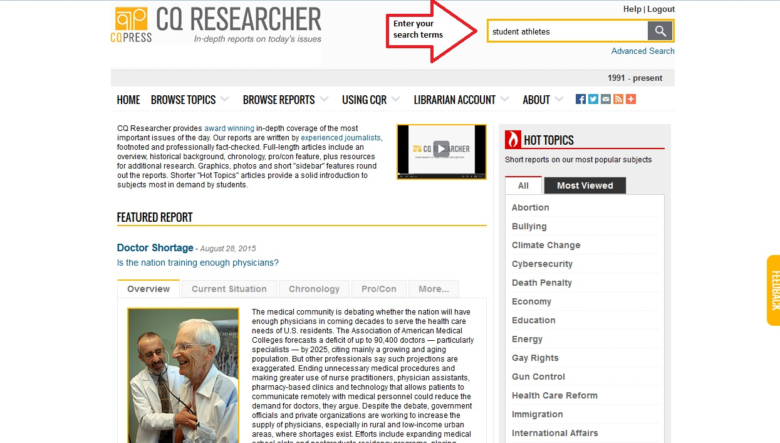
CQ Researcher
Notes:
On the “Databases” page.

Slide 12
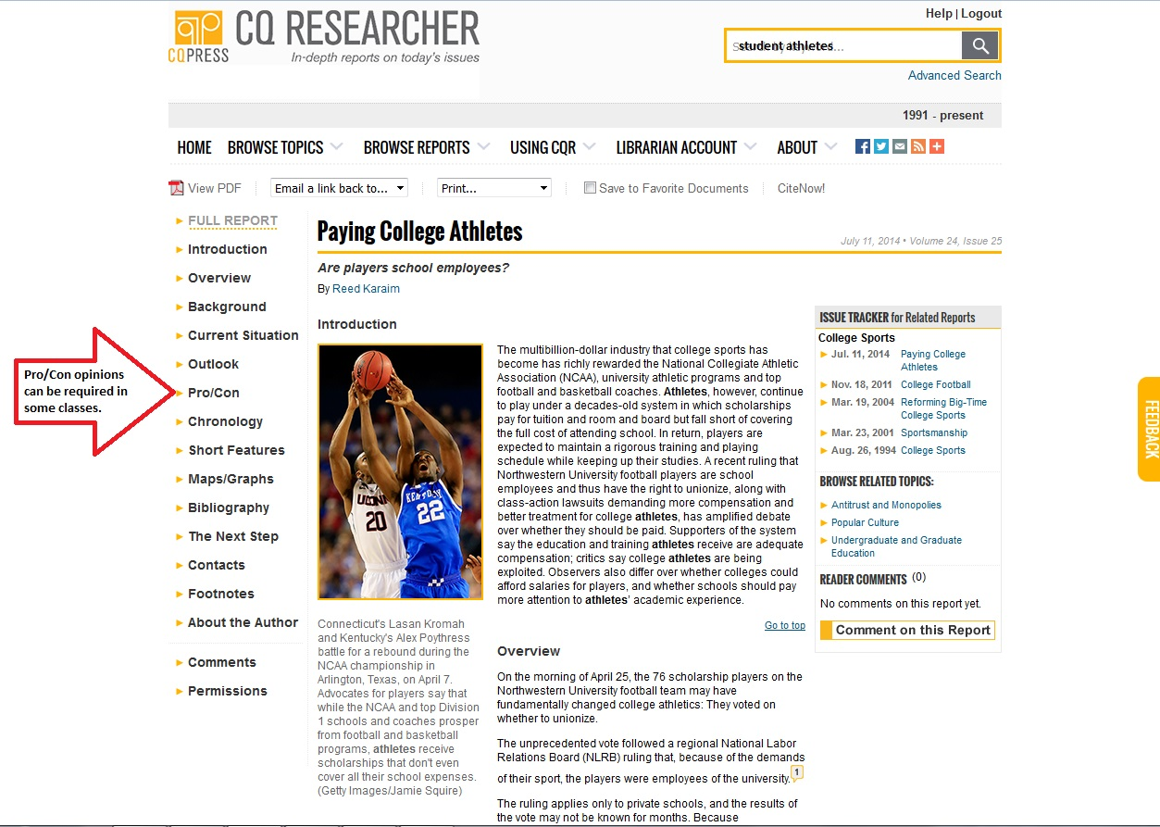
CQ Researcher articles
Notes:
CQ Researcher has a pro/con section in each article.

Slide 13
Gale Virtual Reference Library
Gale Virtual Reference Library
is a good place to find
background information on
a topic as well as more
detailed information.
Notes:
On the “Databases” page.

Slide 14
Gale Virtual Reference Library
Notes:
You can browse by subject or enter a specific search term.
Use the Advanced Search for more sophisticated searching.
Notice the quotes around the keywords “student athletes”.

Slide 15
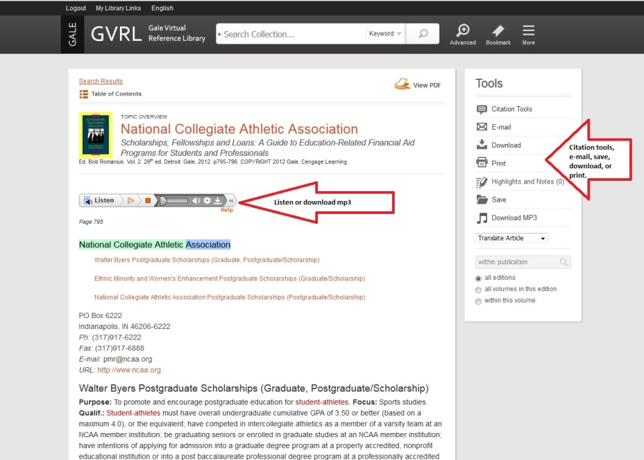
GVRL search results and sample article
Notes:
You can narrow your search results by clicking options on the right side of the search results screen.
Gale articles have the option to download an mp3 of the article.

Slide 16
JSTOR

Slide 17
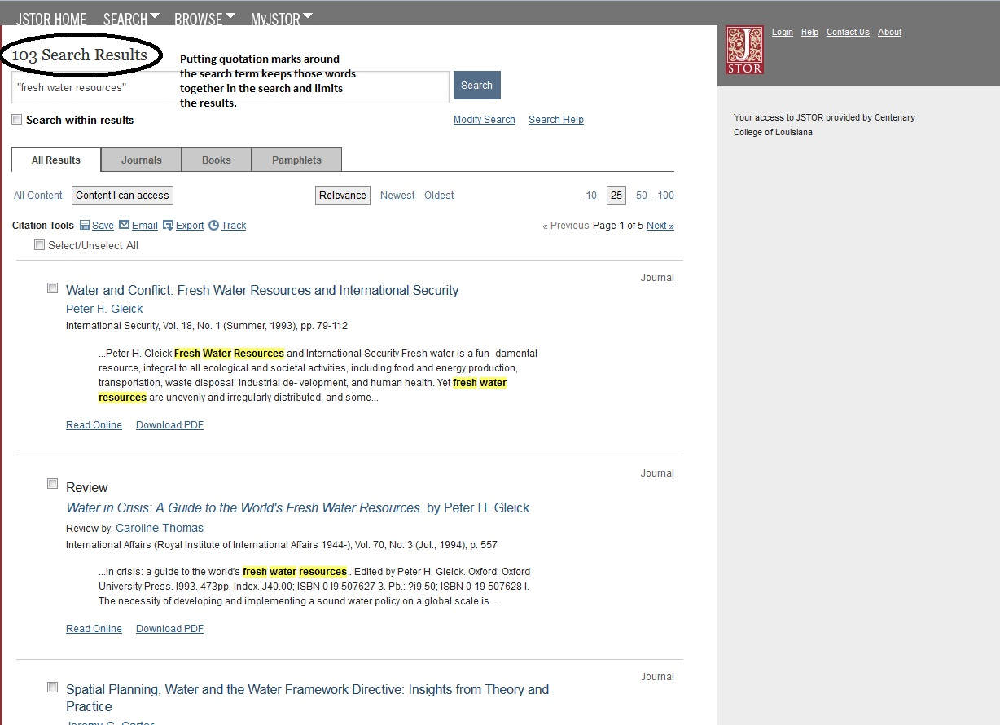
JSTOR search results

Slide 18
LexisNexis and Literati
LexisNexis is useful for news, business, and legal issues.
Literati can help with background information and has an interesting cross-referencing technology called Mind Map.

Slide 19
Literati search results

Slide 20
Literati mind map

Slide 21
Library Resources
Notes:
The Library Resources link has additional research pages with a lot of information sources to help with research.

Slide 22
Databases & Other Resources
There are many more research tools available in Databases & Other Resources. Links to E-Books, E-Journals, Images, Louisiana Resources, Newspapers online, Open Access Resources, tutorials, and subject-specific resources in the Humanities, Sciences and Social Sciences.
Notes:
Additional links to the Online Catalog, Faculty Resources, Distance Learning Resources and Subject Guides.

Slide 23
Using Other Research Links
USE USERNAME Centenary and PASSWORD Mag318
There are many other
resources available to
help with your research.
SUBJECT SPECIFIC RESOURCES
Notes:
Access by clicking on the red “Online Research Page” from the home page.
Stress the Username: Centenary and Password: Mag318 for accessing these resources from off campus.
Full Text Journal Title Finder: some journals have an embargo of a certain time period (i.e. 1 year) in which you cannot access the articles until that time has passed. The journal October in EBSCO has an embargo.
Click on some of the links to familiarize yourself with them.
Click on some of the Subject Guides and Subject Pages to become familiar with those resources.

Slide 24
FYE and other Research Assistance
FYE helpful links

Slide 25
First Year Experience
Link to this
PowerPoint
Notes:
“Citation Forms” has sample MLA, APA, and Turabian citation formats to help with citing papers.
Check out the “Evaluating Resources” links.

Slide 26
Subject resources
Subject specific resources

Slide 27
Useful links
Other useful links:
Interlibrary Loan - request material from another library if it is not available at Magale
Archives – Centenary historical records and LA Methodist Church's records
Contact Us –
869-5047
Notes:
Use Interlibrary Loan when you can’t find what you need at Magale Library. We will request books or journal articles from other libraries to be sent here for you.

