Slide 1
Information Literacy
How to navigate Magale Library’s web resources

Slide 2
How to reach the library website
www.centenary.edu
Notes:
When you go to www.centenary.edu you will see Library near the top right corner of the front page. You can also access the library website by going to www.centenary.edu/library .

Slide 3
Some library basics
Library Hours:
Mon-Thurs: 7:30a-10p
Friday: 7:30-4:30p
Saturday: 1p-5p
Sunday: 2p-10p
Bring your Centenary ID to the Circulation Desk and library staff will put you in the system to be able to check out materials.
The library serves Centenary students, faculty, staff, and alumni of the college. The guidelines and more information can be found on our policies page.
Notes:
Library hours can be found on our front page. Policies can be found at https://www.centenary.edu/library/policies/.

Slide 4
Navigating the Website
Finding print materials and e-books
A-Z list of all databases
A wealth of research tools
How to borrow outside Magale’s System
Notes:
On our front page you will find our menu of things you can do through our web page. The four links indicated with arrows are our most used links on this page, and will take you to our Enterprise e-catalog to search for print and e-book resources, our A-Z list of databases, Library Resources which offers links to research resources as well as subject guides to further guide database usage and other resources based on area of study, as well as our Interlibrary Loan system.

Slide 5
Finding print books and E-books
Notes:
After you select “Search for books, journals, and more,” on the first page, it will take you to this screen. You can narrows down your search topic to all fields or search by title, author, and more.

Slide 6
Finding print books and e-books
Ways to narrow search results
Notes:
Once you have done your search, to the left you will see limiters such as electronic resources or one of the two libraries on campus as well as author type, material type, etc. Selecting these boxes then selecting include or
exclude will concentrate your search to get better results.

Slide 7
E-book listing
Notes:
This is an example of an e-book listing. Note that the call number will say, “Available online,” the Library will list it as an, “Electronic Resource,” and at, “Electronic Access,” it will offer either a direct link,
or a way to access the book online.

Slide 8
Print Book listing
Found on the second floor
Notes:
A print book listing will give a Call Number listed in Library of Congress Classification. Library will be listed as Magale Library (or Hurley Music Library if it’s a music resource).

Slide 9
Big list of databases
Magale Library has over 380 databases, and the alphabetical list can be found under the Database link on the front page menu.
For off campus or at home access, use the following credentials:
Username: Centenary
Password: Mag318
Notes:
If you know what database you would like to use, this list is a great way to access it quickly.

Slide 10
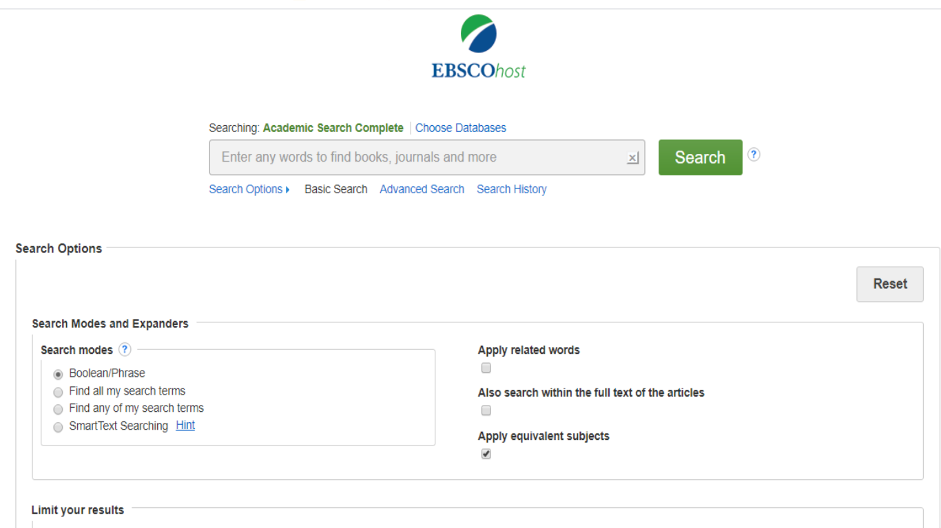
Some of our favorite Databases
Academic Search Complete
You can add additional databases to search in addition to Academic Search Complete
Search limiters
Gives you the ability to search multiple terms at once
Notes:
Academic Search Complete has the ease of a Google search, but with more functionality in limiting or expanding results. You can select a box to search only Peer Reviewed articles as well as limiting
publication date, author, subjects and more. Academic search complete also supplies video and photo results on top of the written articles available.

Slide 11
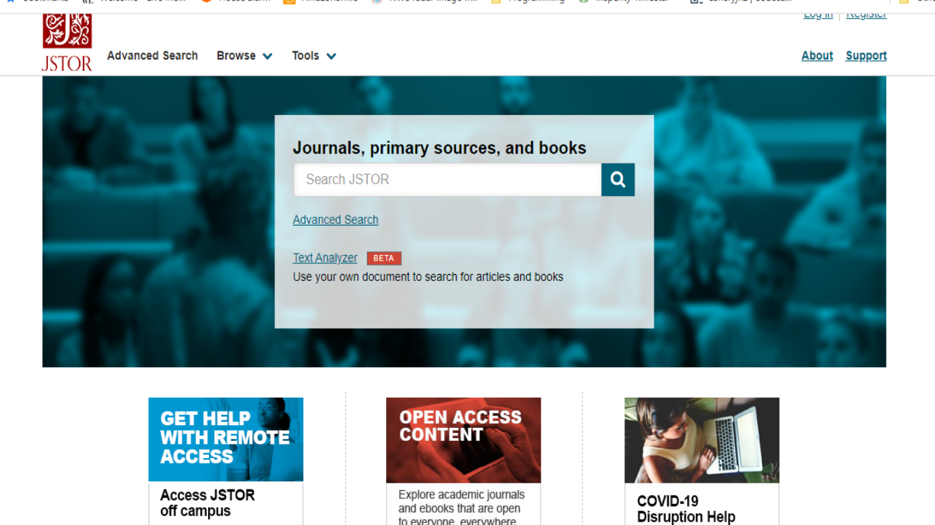
Some of our favorite databases
JSTOR
Notes:
JSTOR also offers a simple search for sources, but can also be limited in Advanced Search to tailor your results. You can also upload your own paper to the Text Analyzer to have JSTOR pull relevant subjects for searching as well.

Slide 12
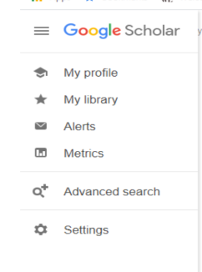
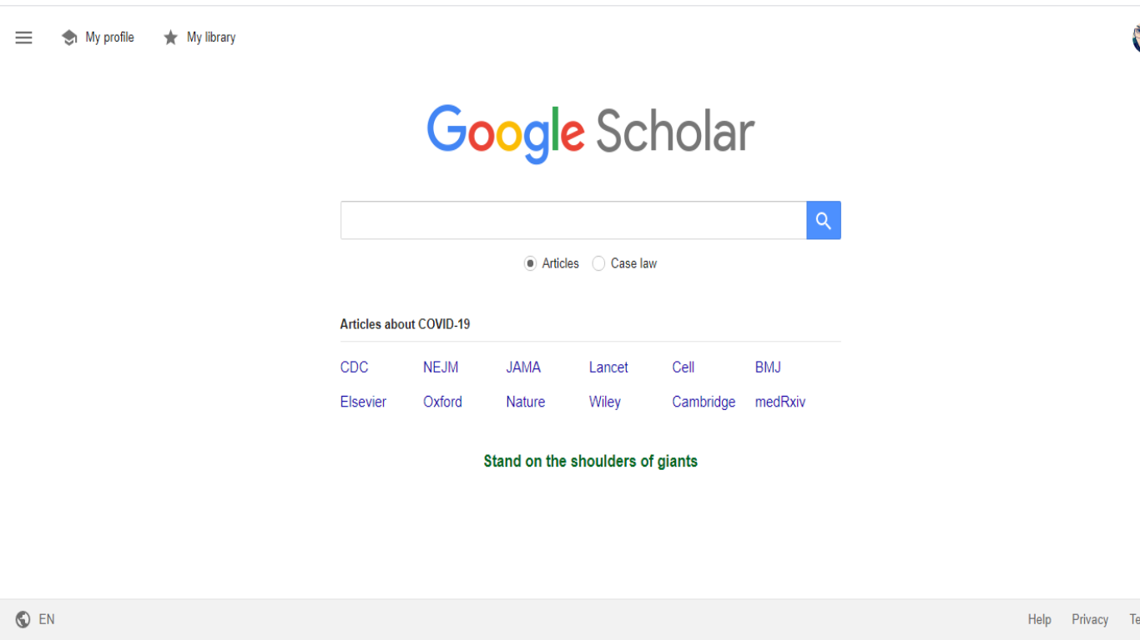
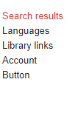
Some of our favorite databases
Google Scholar
Notes:
Google Scholar offers the ease of a Google search, but with more trustworthy results of scholarly articles and case law. By going to the menu in the top left corner then selecting Settings then Library Links, you can enter Centenary College in the search and select the box. This will give you the opportunity to search both Open WorldCat through Google scholar AND Centenary College’s ProQuest Full-text database, therefore giving you two searches for the price of one.

Slide 13
Library resources
Selecting Library Resources on the front page will bring you to this screen.
Here you will find Research Resources, Electronic resources such as journals and faculty resources, and subject guides which contain specific lists of useful databases as well as other resources.

Slide 14
Research resources
Here in Research Assistance, you will find citation help and writing exercises, ways to evaluate sources, and information to aid in taking and teaching TREK courses.
Notes:
Our Research Assistance column holds a wealth of information for researching subjects. Writing Labs takes you to The Purdue Writing Labs which contain citation guides and writing exercises to strengthen academic writing. Reference Source hold links to tools for evaluating sources, such as the C.R.A.P test, which we’ve found is easy for the student to remember because of the name. TREK information covers things that are useful to first, second,
and third year TREK students. The Plagiarism link offers the definition of plagiarism, as well as ways to evaluate whether something is plagiarized. This helps students learn how to maintain integrity in working on assignments.

Slide 15
Subject Guides
Notes:
For those times that you aren’t sure what database to use, you can go to the Subject Guides under the Library Resources link and go to the subject you’re studying. This will give you a targeted list of databases
that will most closely fit what subject you’re researching. There are also other related links in these guides that may be useful in your studies.

Slide 16
What is interlibrary loan?
As shown on the main library page, another option in acquiring materials is our Interlibrary Loan link.
When you search our resources and aren’t able to find what you’re looking for, Interlibrary Loan may be the answer.
Putting in an ILL request for a book or journal article will send us a notification that you need this material type, then we will access the ILL database and find a participating library elsewhere to borrow this material from.
Acquisition of ILL journal articles can take 24 hours to 3 days, while books can take 1-4 weeks depending on where we borrow the item from. Because of this wait time, ordering through Interlibrary Loan does require some foresight—get your research done early.
Once your order is placed, you can log back into the link to check the status of your request.

Slide 17
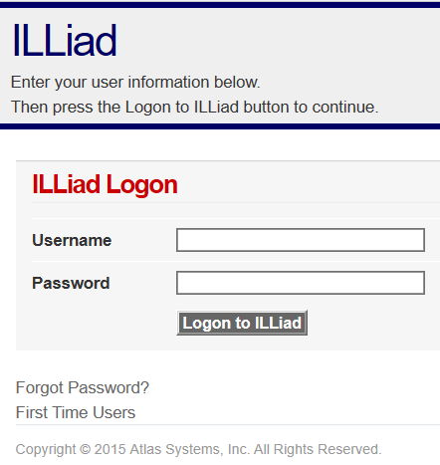
ILLiad interlibrary loan system
Notes:
If you are seeing this screen for the first time, you MUST click on the “First Time Users” link and register for ILLiad. PLEASE COMPLETE THE FORM. You only need to do this ONCE.
Record your username and password or take a camera shot with your phone. You are then ready to request any books or articles you need for research.

Slide 18
Interlibrary Loan
Types of materials you may request

Slide 19
Contact us
To set up in person tutorials on any library resources, or for any additional questions please contact us at the following:
Christy Wrenn, Director: cwrenn@centenary.edu
Ashley Rulo, Assistant Director: arulo@centenary.edu
Sharon Chevalier, Access Officer: schevali@centenary.edu

